Slide 1
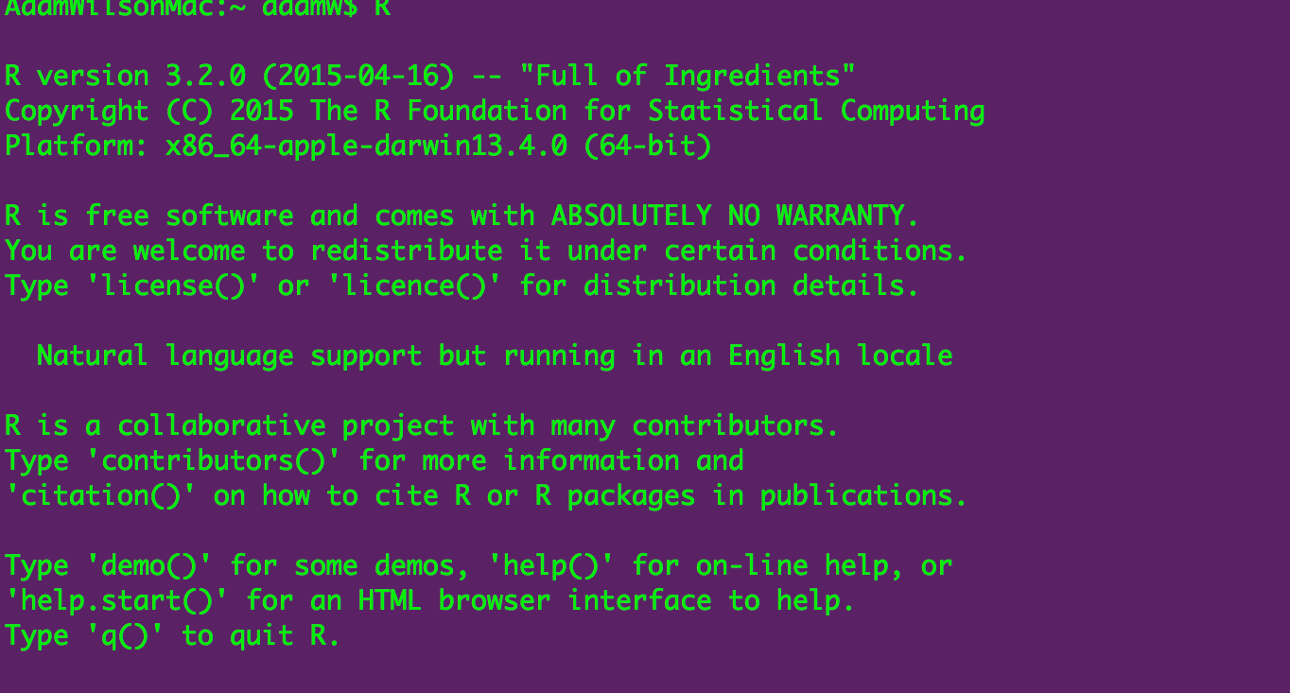
Spatial environmental data analysis with R GEO 503

Slide 2
Agenda
Quick introductory presentation
Hands-on exercises
adamwilson.us/RDataScience
Please interrupt!

Slide 3
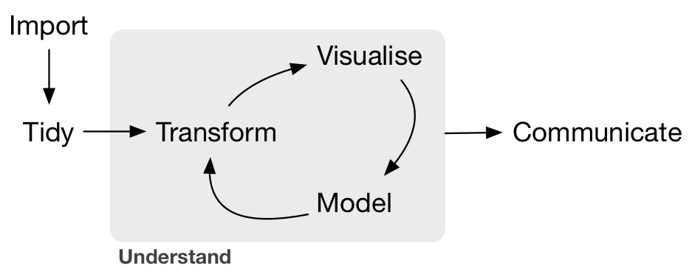
Data Science?
--Grolemund & Wickham, R for Data Science, O'Reilly 2016

Slide 4
On programming
“Programming ought to be regarded as an integral part of effective and responsible data analysis”
- Venables and Ripley. 1999. S Programming
You can figure it out!

Slide 5
A table ‘named’ iris.
Row | Sepal.Length | Sepal.Width | Petal.Length | Petal.Width | Species
1 | 5.1 | 3.5 | 1.4 | 0.2 | setosa
2 | 4.9 | 3 | 1.4 | 0.2 | setosa
3 | 4.7 | 3.2 | 1.3 | 0.2 | setosa
4 | 4.6 | 3.1 | 1.5 | 0.2 | setosa
5 | 5 | 3.6 | 1.4 | 0.2 | setosa
mean(iris$Sepal.Width)
filter(iris, Sepal.Length<4.9)
iris$Sepal.Length + iris$Petal.Length

Slide 6
It won’t take long before you can ‘read’ this…
space.only <- gam(present~s(X_CEN, Y_CEN), data=finch@data, family="binomial") preds.space.only <- as.numeric(predict(space.only, type="response")) resid.space.only <- residuals(space.only) finch$space=as.numeric(predict(space.only,type="terms"))
ggplot(finch@data, aes(x=x,y=y,z=space, map_id = id)) + geom_map(aes(fill = space), map = pfinch)+ geom_point(aes(col=as.logical(present)))+ expand_limits(x = pfinch$long, y = pfinch$lat)+ scale_fill_gradientn(colours= c("darkblue","blue","grey","yellow","orange","red"))+ scale_color_manual(values= c("transparent","black"),name="Present")+ coord_equal()

Slide 7
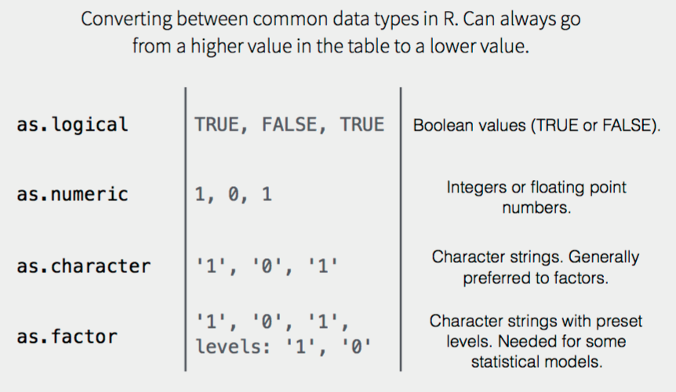
Data Types

Slide 8
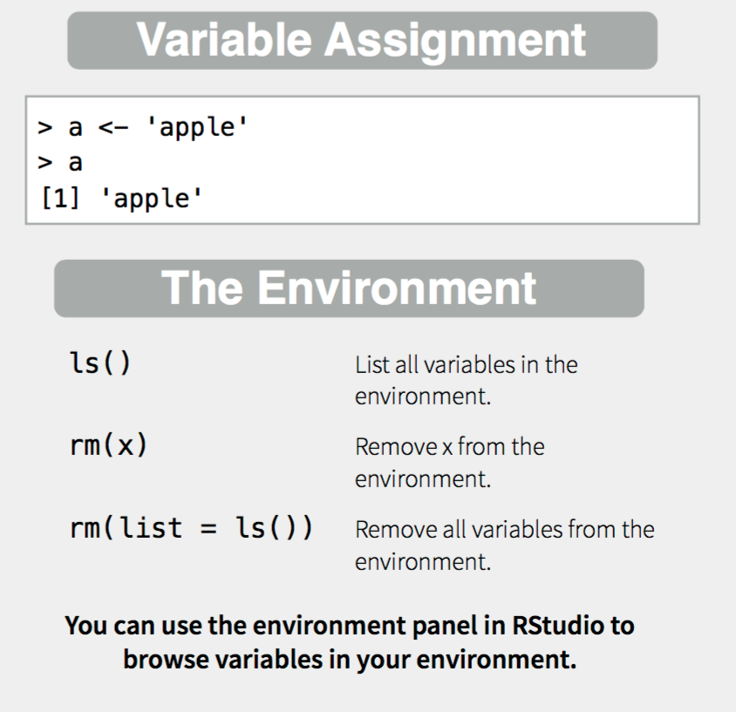
Creating and destroying objects

Slide 9
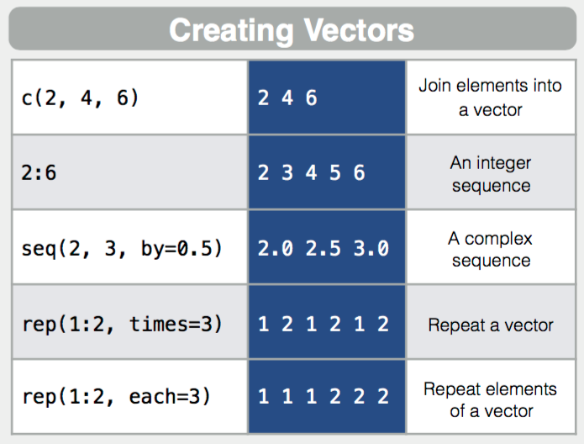
Vectors

Slide 10
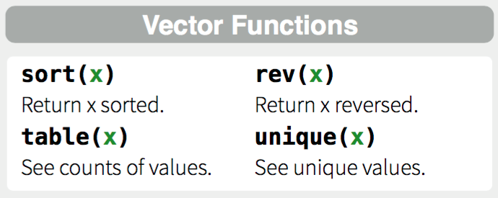
More with dplyr later

Slide 11
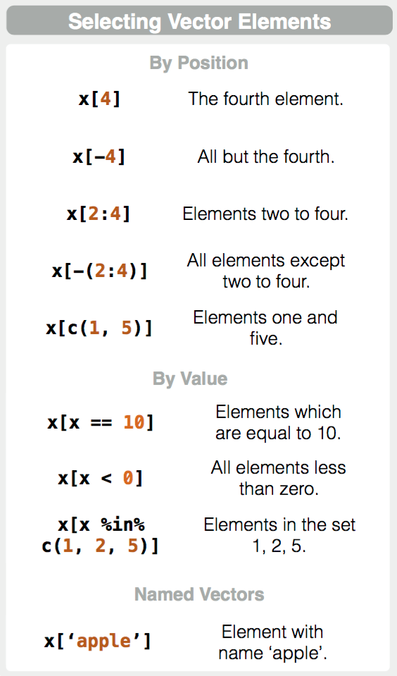

Slide 12
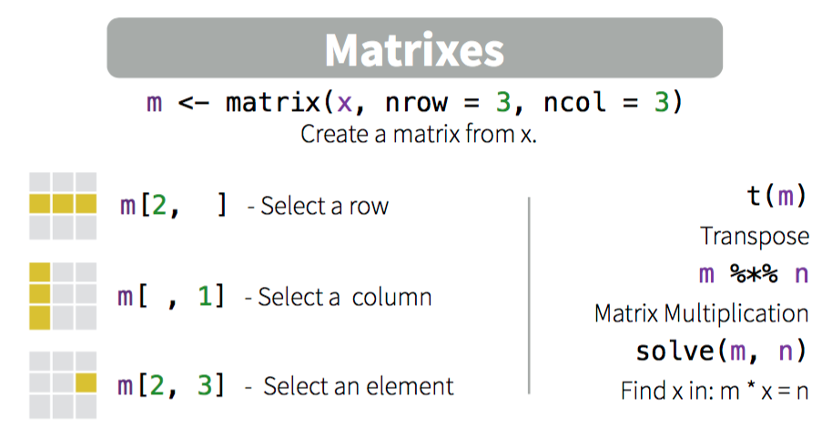
Working with Matrixes (matrices)

Slide 13
3 Basic indexing operators
x[i] x[i, j] x[[i]] x[[i, j]] x$a x$"a"
Vectors and matrices: use [ rarely used
[[drops any names or dimnames attribute & partial matching is used
Multi-dimensional structures with a single index: x[[i]] or x[i]
return the i^{th} sequential element of x
Lists:
[[ select single element
[ returns a list of selected elements.
[[
allows only a single element to be selected using integer or character indices,
[
allows indexing by vectors.
$: recursive objects (lists and data.frames). Only literal character string or a symbol as the index. The index is not computable. If you need to evaluate an expression to find the index, use x[[expr]].

Slide 14
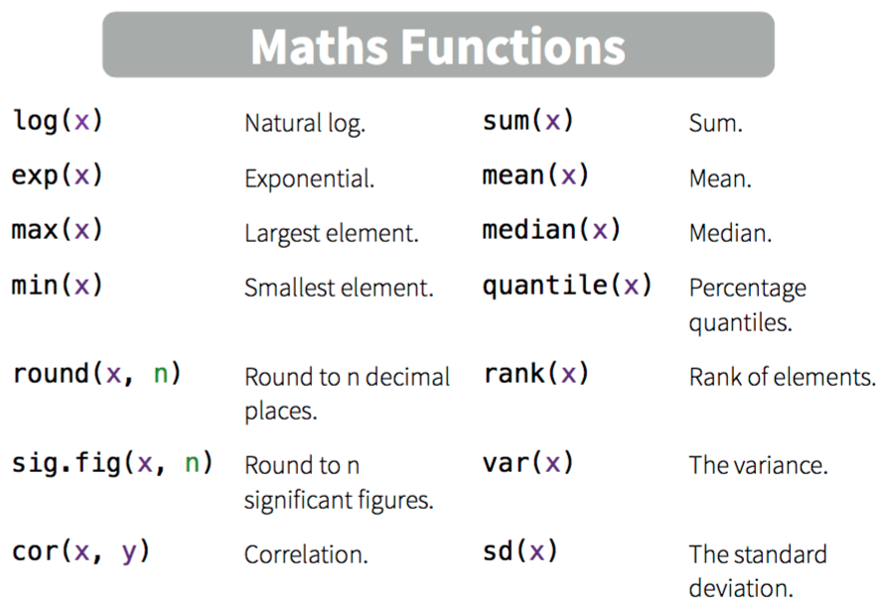
Working with Matrixes

Slide 15
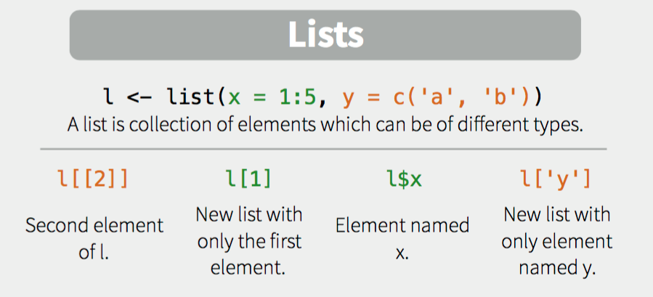

Slide 16
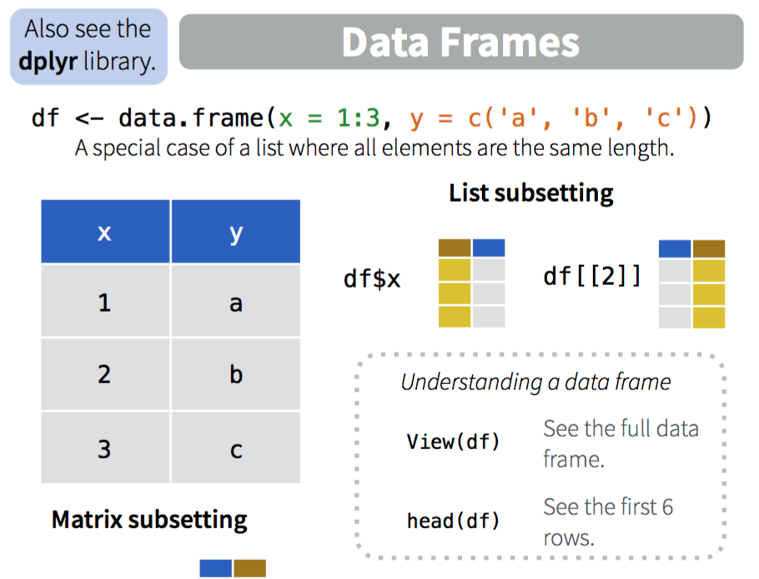

Slide 17

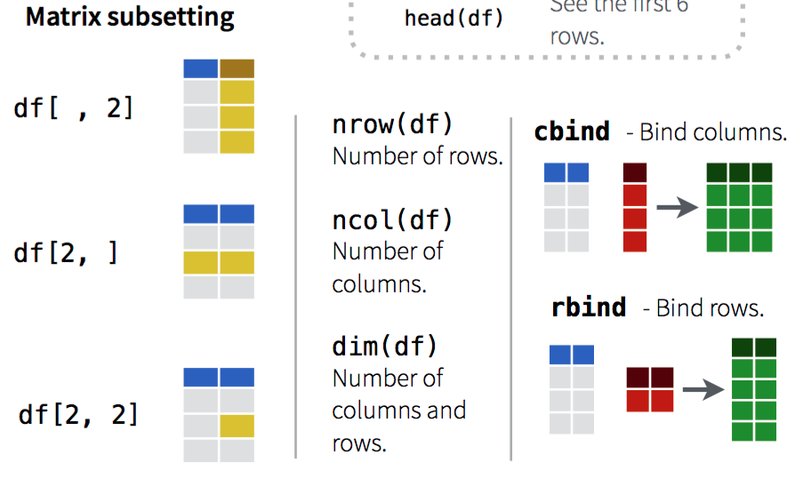

Slide 18
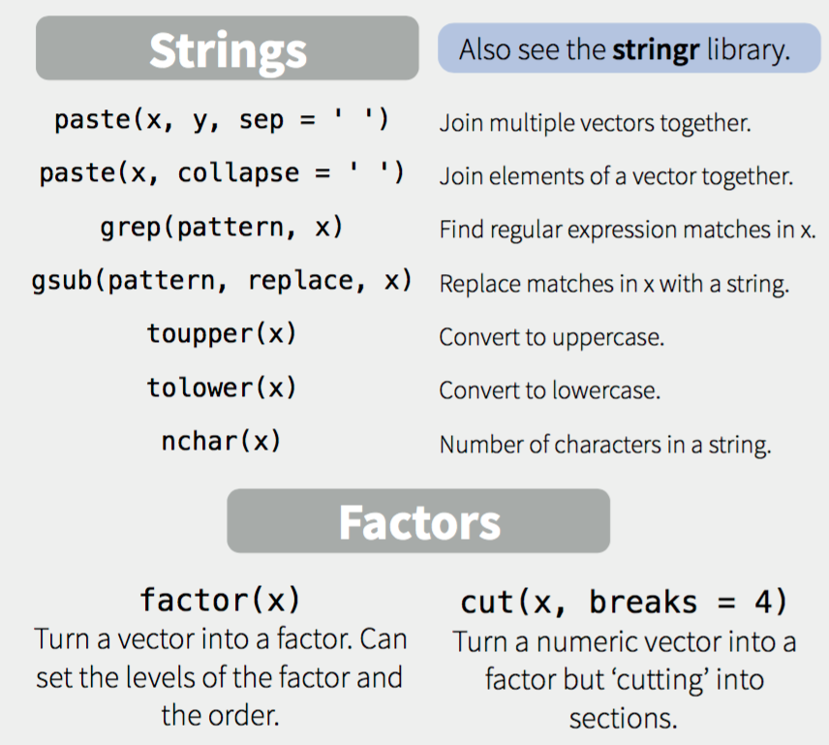

Slide 19
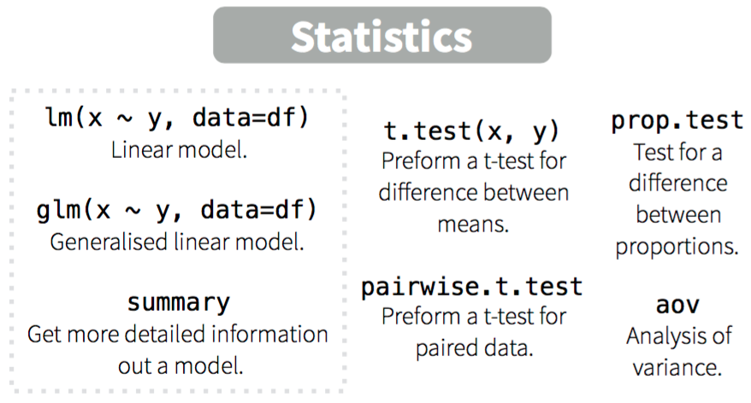

Slide 20
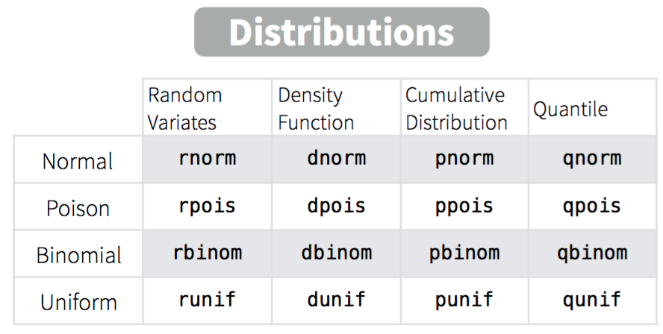

Slide 21
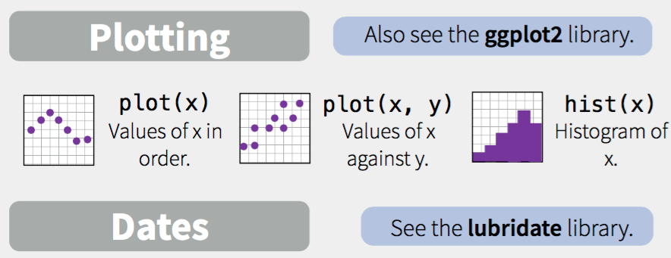

Slide 22
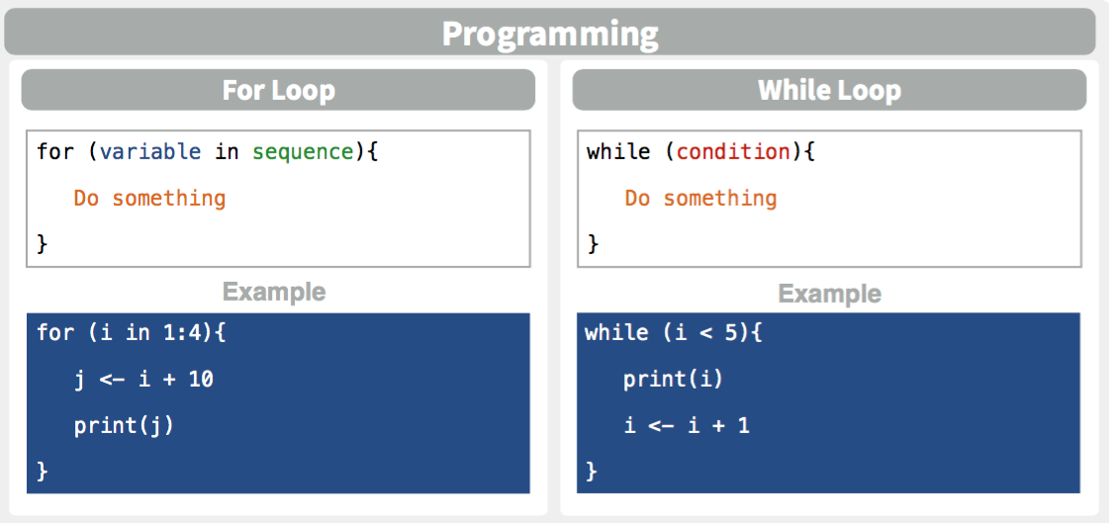

Slide 23
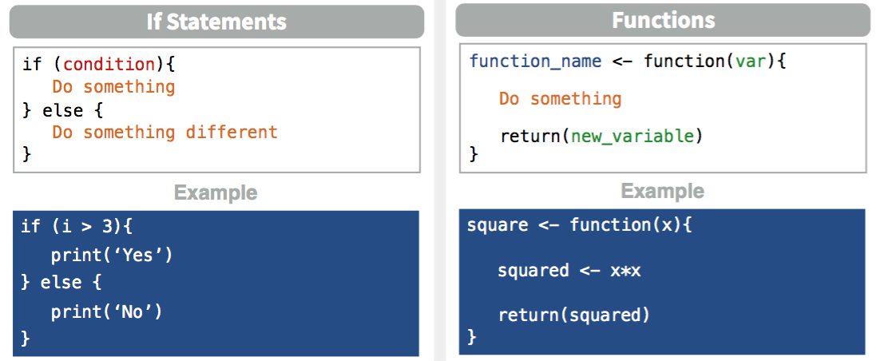
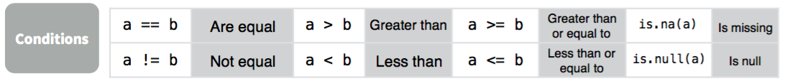
If statements and functions

Slide 24
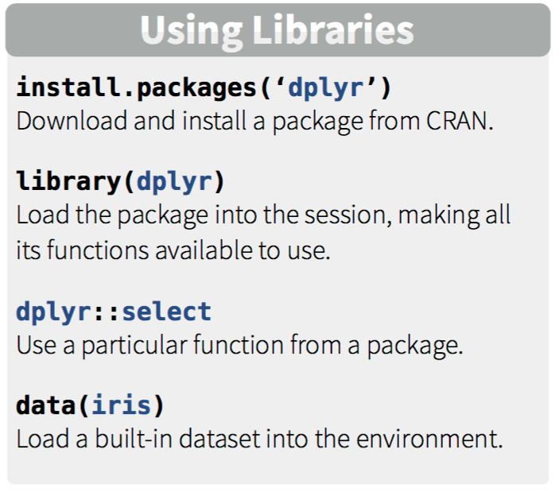
Libraries

Slide 25
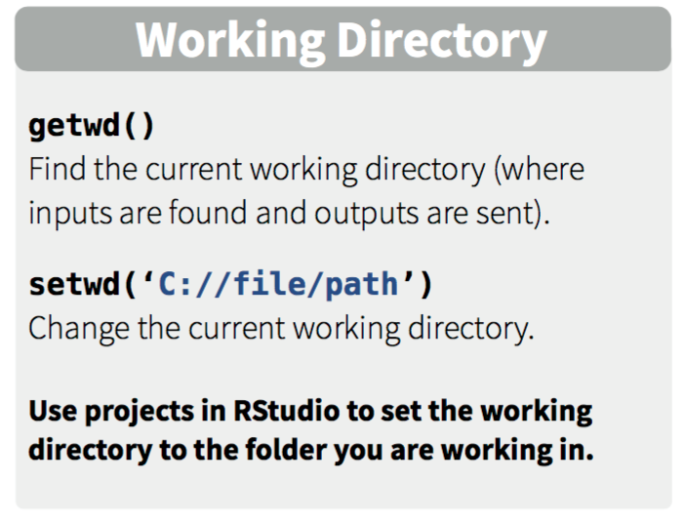
Working Directory

Slide 26
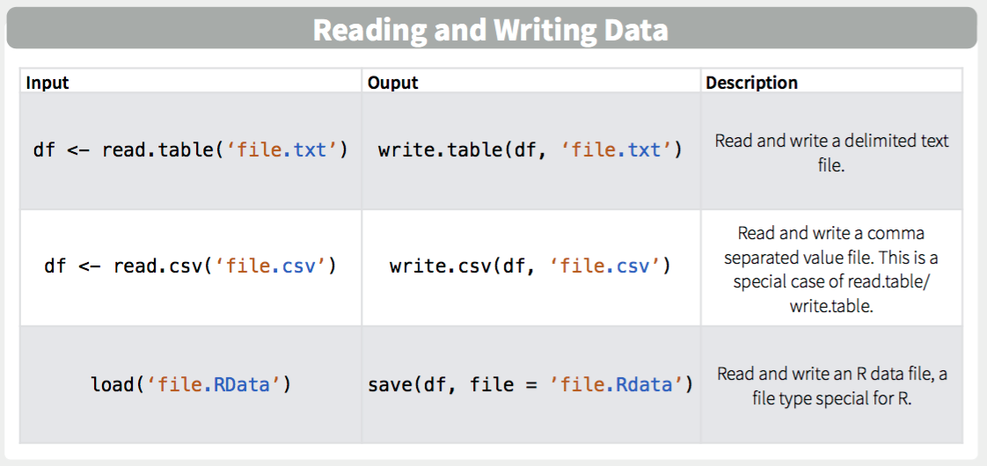

Slide 27
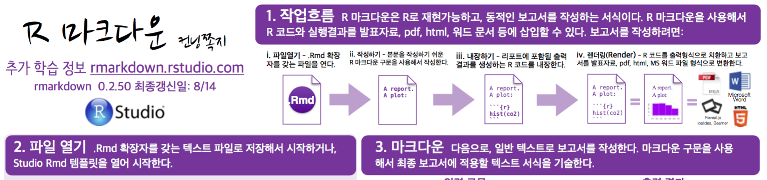
Cheatsheets
Check out https://www.rstudio.com/resources/cheatsheets/ for more cheat sheets summarizing R and related projects…
RMarkdown Cheatsheet in Korean

Slide 28
Homework Notes

Slide 29
Homeworks
Homework #1 Due Next Monday before class (8:30AM)
2 Attempts for First Homework
’Example’ Homework available
Find it in UBLearns

Slide 30
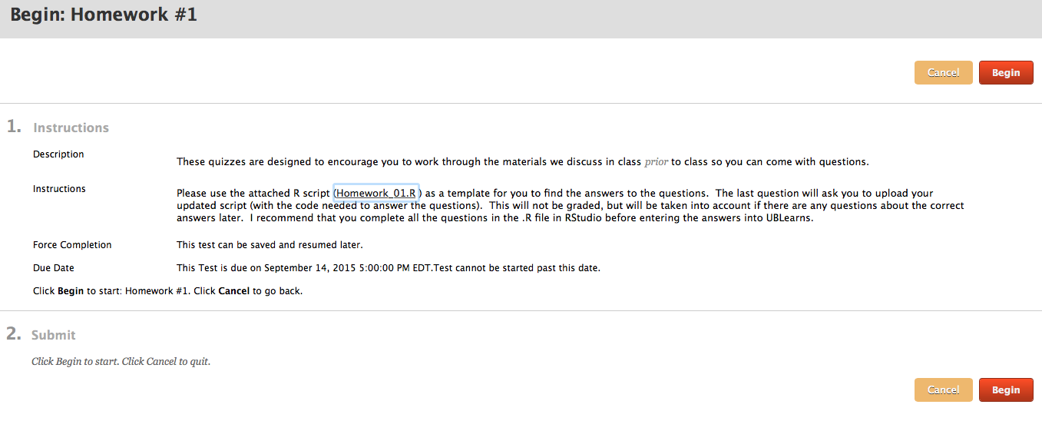
Homework submitted in UBlearns
Working collaboratively is encouraged but you are responsible for developing your own code to answer the questions:
Acceptable: “which functions did you use to answer #4?”
Unacceptable:“please email me your code for #4.”

Slide 31
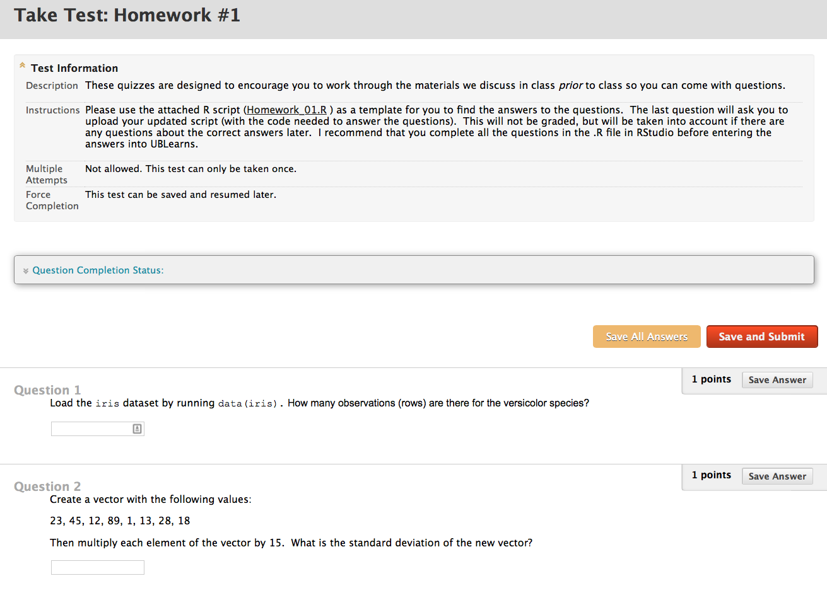
Homework format

Slide 32
R Introduction
Please interrupt!

Slide 33
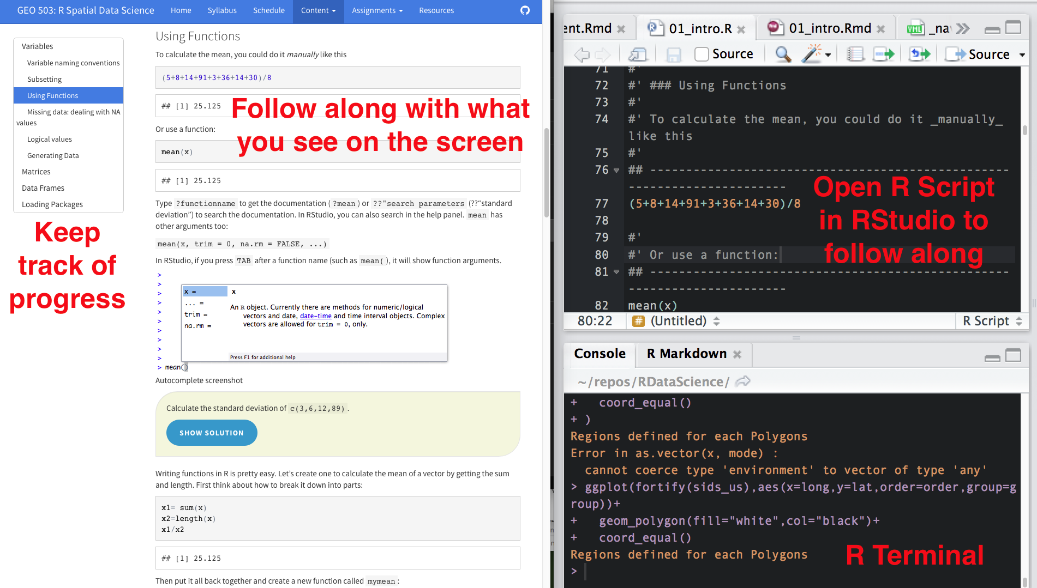
Set up your screen
On the screen

Slide 34
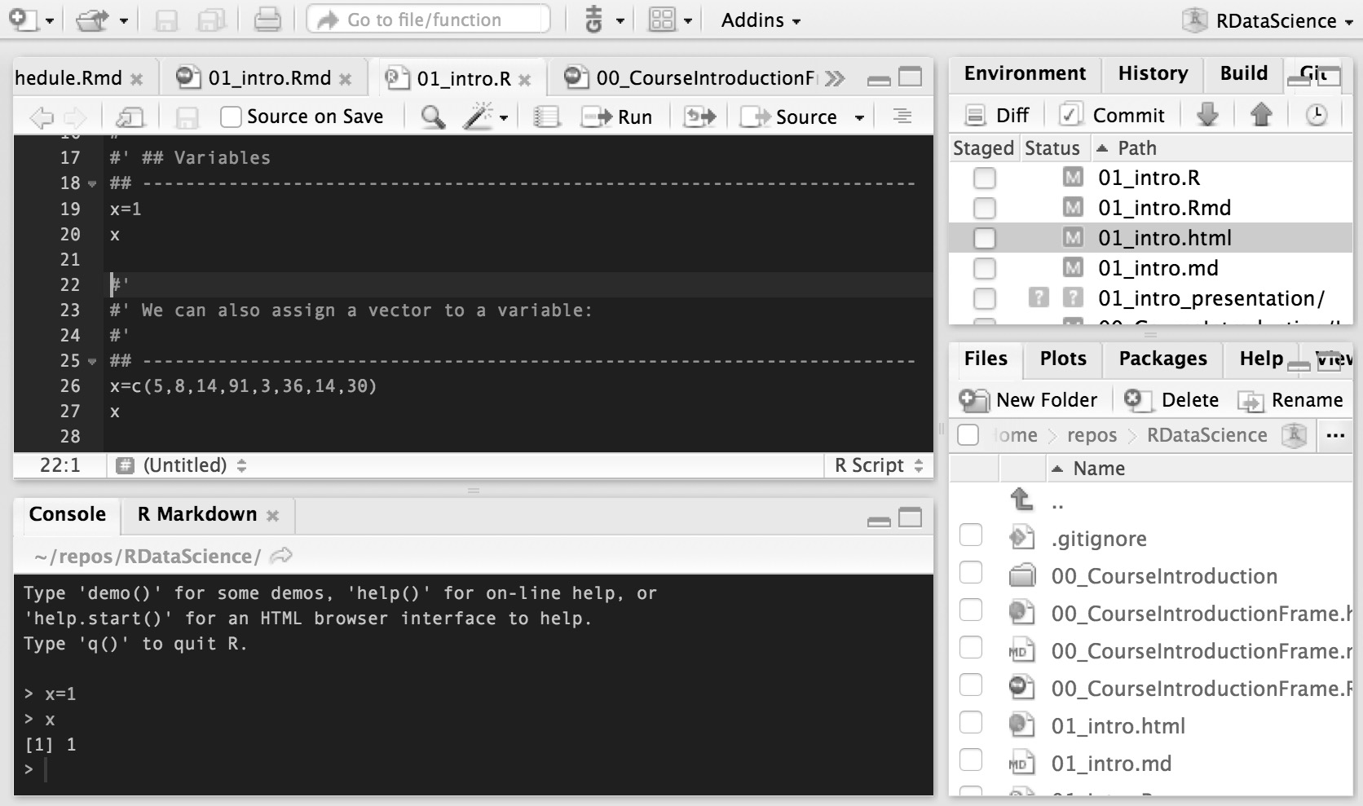
Take time to learn efficient flows…
Write code here
Ctrl (or command)-R will run a line (or whatever is highlighted)
Outputs appear here, did you get what you wanted?

Slide 35
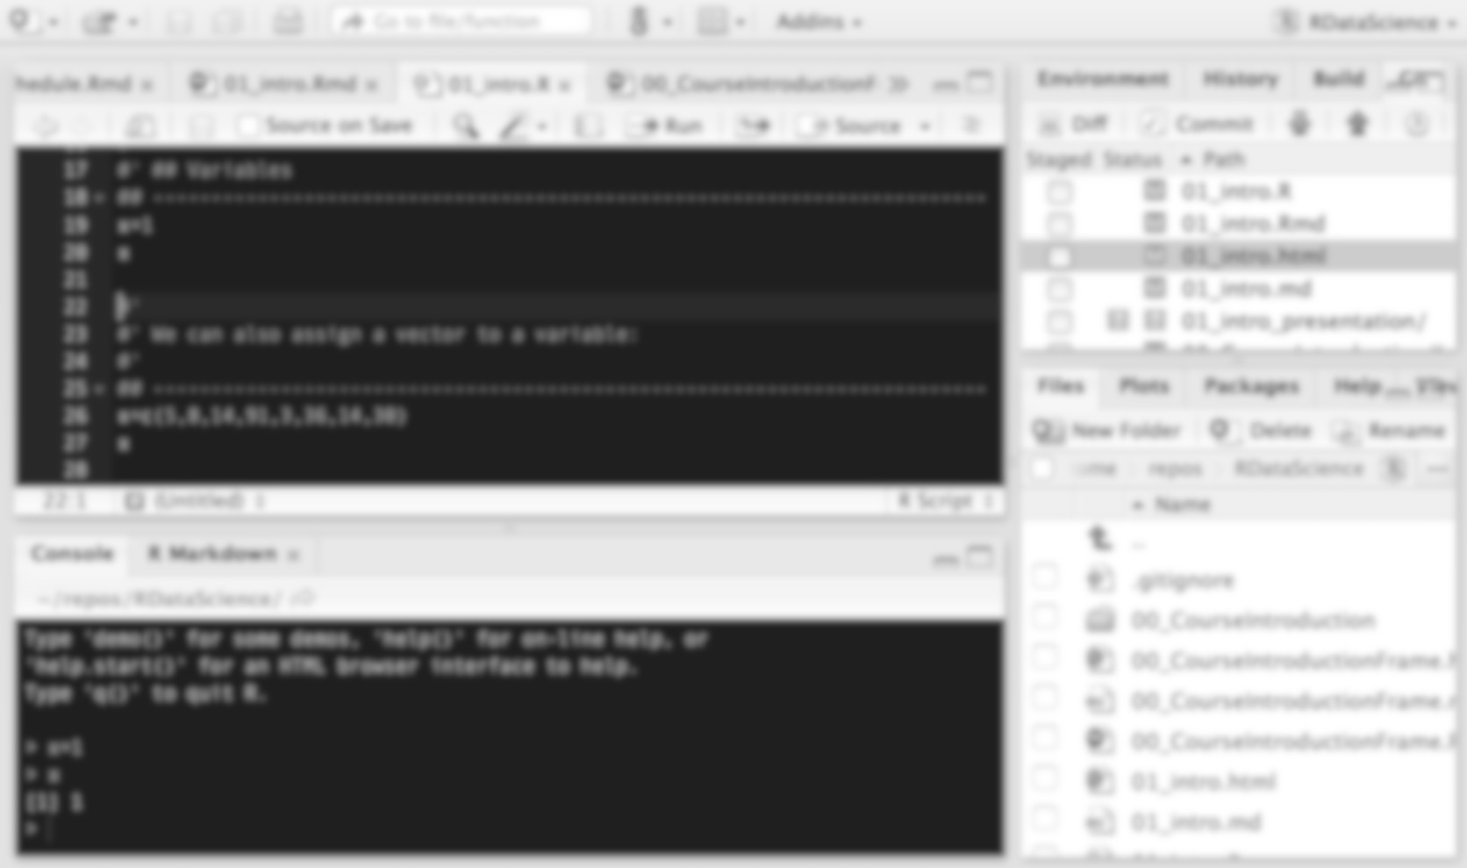
Take time to learn efficient flows…
Your code is your product!
Your outputs are ephemeral

Slide 36
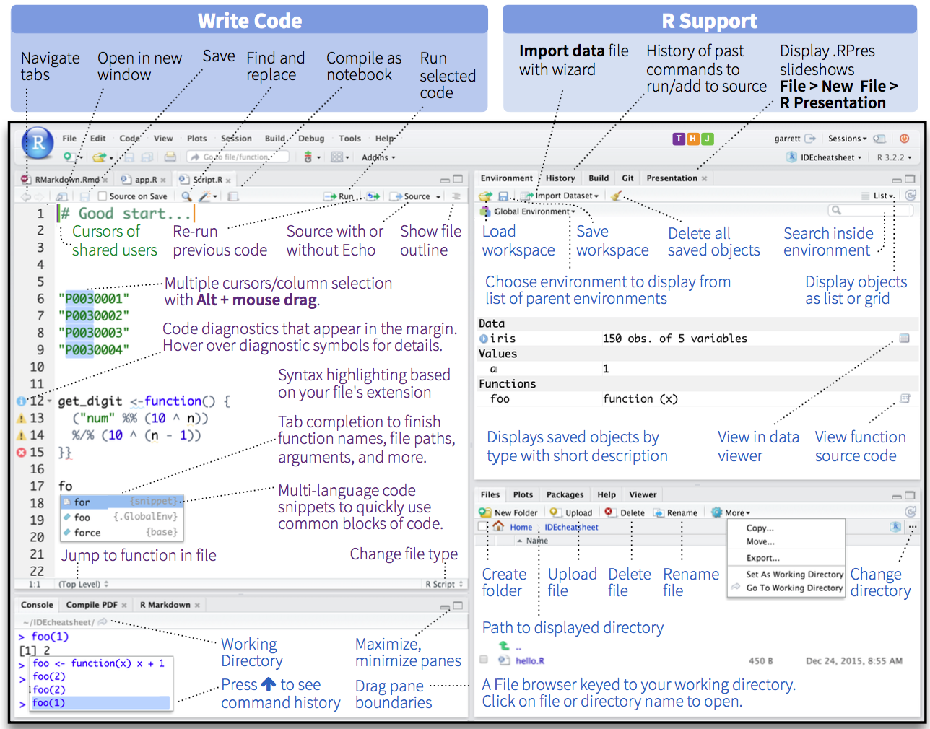

Slide 37
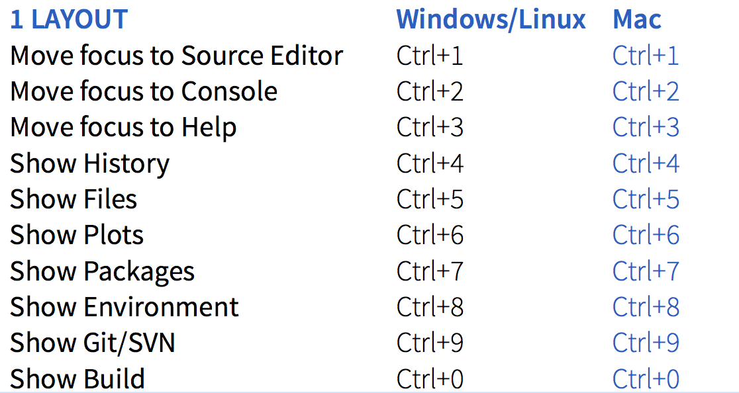
RStudio Keyboard shortcuts for (nearly) everything
Focus on use of ctrl (command) -R for sending code

